Slide 1
Image Noise
Multiplicative noise
Multiplicative noise, also known as speckle noise, refers to an unwanted random signal that gets multiplied into a signal during the capture, transmission, or processing process.
It can be reduced by adaptive filters, which are better at preserving edges and details, as well as non-adaptive filters, such as the moving average and median filters, which are simpler and require less computational power.

Slide 2
Image Noise
Multiplicative noise
For this exercise, you are tasked to corrupt an image with Multiplicative noise.
The algorithm takes as input an image, creates a random noise signal, and multiplies it with the clean image. Then the noise image is returned. Finally, the original image is displayed alongside the noise one.

Slide 3


Image Noise
Multiplicative noise
Input example.
Intermediate output example.

Slide 4
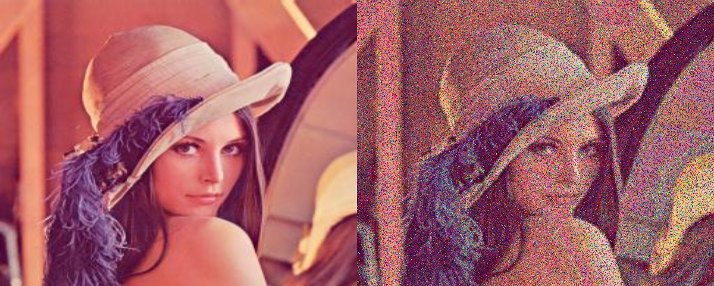
Image Noise
Multiplicative noise
Output example.

